Slide 1





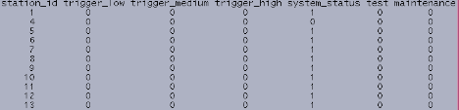
AEIC (Fairbanks)
Sun workstations aeicpipe and aeicems are designed to mirror each other, providing failover.
Input: seismic data from pipeline network and event origins from regional AEIC network. Also user defined states (calibration, maintenance).
Output: state matrix. Determined within Antelope, but mirrored to MySQL database, which is queried by OCC server.
Seismic data, earthquake origins & user-defined states
aeicpipe
OCC (Anchorage)
OCC display
console
firewall
aeicems
OCC server
State Matrix
Off/on states (marked by 0 or 1) for each pipeline station
Has an alarm been declared at the station?
Is the station operating?
Is it being calibrated?
Is it down for maintenance?
Has an event just occurred?

Slide 2
Threshold alarm
Thresholds (and other settings) for each station can be configured different (identical presently).
Seismic data filtered from 0.01 to 4 Hz.
Compares a 2 minute average with threshold settings. If exceeded an alarm is declared.
Alarm stays active for at least 1 minute. Seismic signal may increase during this time, activating higher alarm states (medium, high).
These bits are changed to 1 if there is a low, medium or high threshold alarm declared
THRESHOLD SETTING | % normal gravity | m / s²
trigger_low | 8% | 0.785
trigger_medium | 15% | 1.47
trigger_high | 200% | 19.6

Slide 3
State Matrix continued...
System status : Is station operational?
Test Is station currently being calibrated? (twice a month)
Maintenance Is station in need of maintenance (e.g. are diagnostics being run?)
There is also an event bit in the MySQL database, set whenever an earthquake above a certain magnitude occurs within range of the pipeline corridor. This is explained in the next slide...

Slide 4
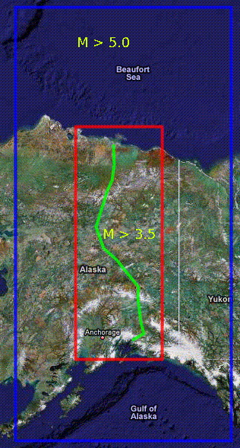
Earthquake Event Notification
AEIC typically detects about 50 earthquakes each day in Alaska, but most are too small or too far from the pipeline to be of concern.
Earthquakes greater than magnitude 5 in the blue box, and greater than magnitude 3.5 in the red box, are broadcast to the OCC (via the event bit) and Doug Nyman (via XML files).
They also trigger ShakeMaps, providing there are at least 10 arrivals, and intensity (MMI) >= 2 at the epicenter.
Spectral calculations are also made for earthquakes M > 3.8.

Slide 5
AEIC (Fairbanks)
XML files
(earthquakes matching criteria, ShakeMaps, deleted events)
Seismic data & earthquake origins
TAPS ShakeMap
system
webserver
Alyeska system
website
firewall
Here is the XML describing one earthquake event.
This can change. AEIC automatically computes better origins (and magnitudes) as more data become available – as seismic waves propagate across a 400 station network.
Analysts review solutions and may even delete events if they are false (rare, but can happen).
As new origin solutions become available, ShakeMaps are recomputed.
<event>
<event_id>Tsaina_se</event_id>
<origin_time>05/22/2008 18:08:00.000</origin_time>
<latitude>61.2670</latitude>
<longitude>-145.6800</longitude>
<magnitude>7.1</magnitude>
<shakemap>y</shakemap>
<arrivals>10</arrivals>
<review>y</review>
<timestamp>5/22/2008 18:08:00.000</timestamp>
</event>

Slide 6
The Fuzzy Boundary Problem
Because event origins are automatically “improved” as more data become available, an event that initially satisfies the criteria may:
Move out of the red or blue boundary
Be reassigned a magnitude that no longer qualifies.
AEIC can either “cancel” the event (remove it from the XML file, cancel the event bit, and remove it from the ShakeMap system). Or it can continue to track an event which no longer qualifies. Currently we do the latter.
Spectral calculations are only made for earthquakes greater than magnitude 3.8. So if a magnitude 3.9 event is reassigned magnitude 3.7, the spectral calculations will disappear.

Slide 7
TAPS ShakeMap & XML systems
Tested extensively with Alyeska system in coordination with Jimmy De La Garza & Doug Nyman
Suite of 10 simulated earthquake origins used, 19 step sequence
Test script can be re-run at anytime
Conditions tested:
Origin No. | Origin Name | Mag. | Depth | Latitude | Longitude
1 | Denali 1 | 7.3 | 4.2 | 63.5141 | -147.4529
2 | Coldfoot 1 | 4.2 | 10 | 67.2230 | -149.8090
3 | Prince William Sound 1 | 4.1 | 10 | 61.0170 | -147.6480
4 | Tsaina 1 | 6.7 | 10 | 61.2670 | -145.6800
5 | Denali 2 | 7.4 | 5.2 | 63.5131 | -147.4539
6 | Salcha 1 | 4.2 | 10 | 64.6100 | -147.1200
7 | Tsaina 2 | 6.8 | 11 | 61.2680 | -145.6810
8 | Tsaina 3 | 6.9 | 11 | 61.2670 | -125.6820
9 | Prince William Sound 2 | 4.2 | 10 | 61.0160 | -147.6470
10 | Denali 3 | 7.5 | 5.2 | 63.5161 | -147.4549
1. New qualifying event
2. New preferred origin that qualifies
3. New ShakeMap
4. Manually modified ShakeMap
5. New preferred origin that does not qualify
6. Manually cancelled event

